Slide 1
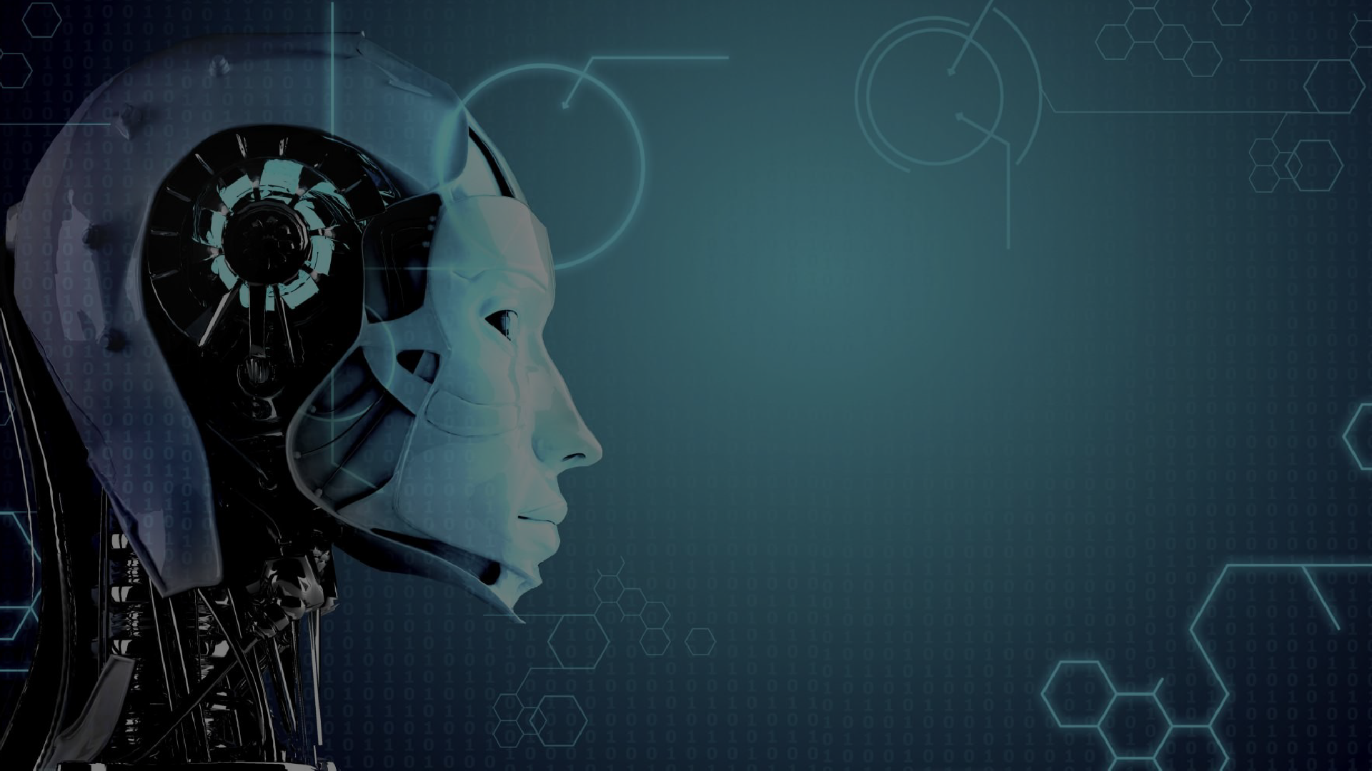
Artificial Intelligence (AI)

Slide 2
What do you think Artificial Intelligence is?

Slide 3
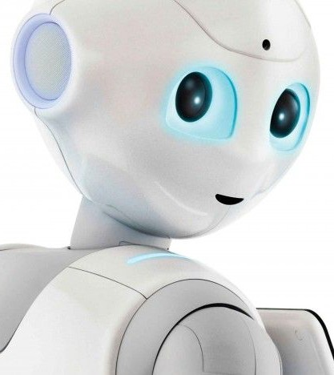
What is Artificial Intelligence?
Hear the term artificial intelligence (AI) and you think of self-driving cars, robots, ChatGPT or other AI chatbots, and artificially created images. But it's also important to look behind the outputs of AI and understand how the technology works and its impacts for this and future generations.
AI is a concept that has been around, formally, since the 1950s, when it was defined as a machine's ability to perform a task that would've previously required human intelligence. This is quite a broad definition and one that has been modified over decades of research and technological advancements.

Slide 4
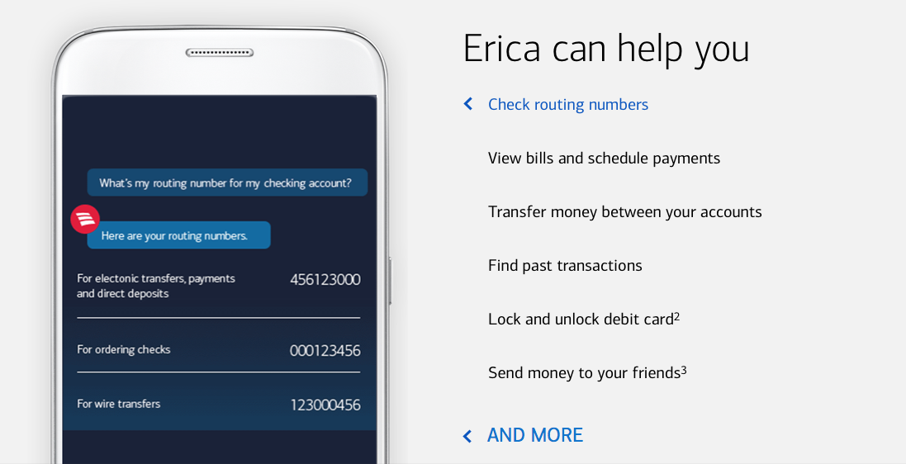
How can AI help us today?
AI can help by managing repetitive tasks and routine tasks so we can focus on the most important tasks in our to-do list.
Example: Erica an AI that is the virtual financial assistant used by the BANK OF AMERICA.

Slide 5
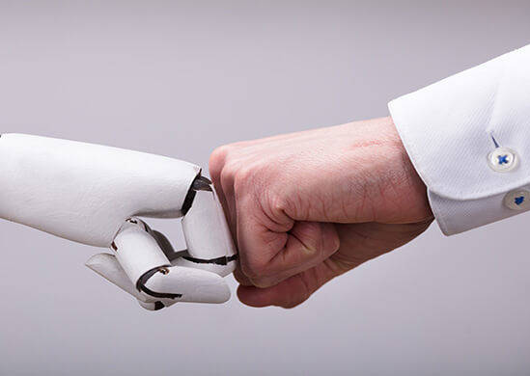
Most common AI uses
AI comes in different forms that have become widely available in everyday life. The smart speakers on your mantle with Alexa or Google voice assistant built-in are two great examples of AI. Other good examples are popular AI chatbots, such as ChatGPT, the new Bing Chat, and Google Bard.
When you ask ChatGPT for the capital of a country or you ask Alexa to give you an update on the weather, you'll get responses that are the result of machine-learning algorithms.
Though these systems aren't a replacement for human intelligence or social interaction, they have the ability to use their training to adapt and learn new skills for tasks that they weren't explicitly programmed to perform.

Slide 6
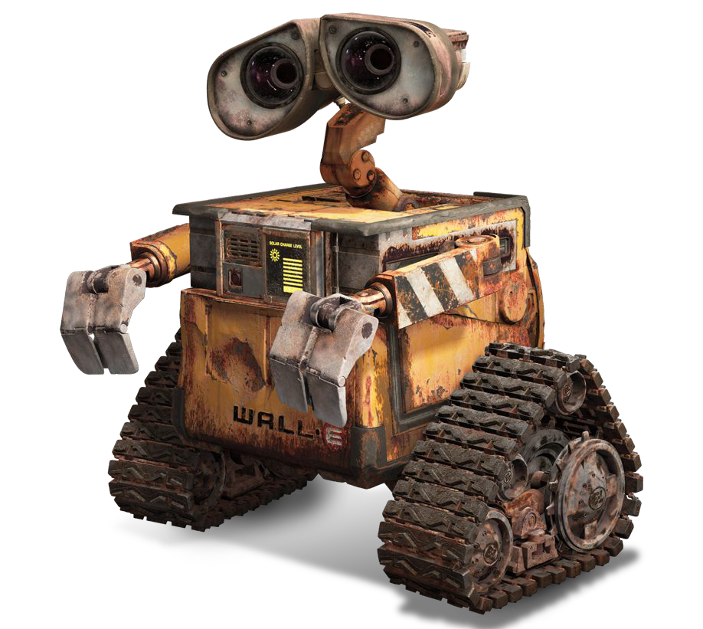
Artificial Intelligence in Movies
In movies, robots have the capacity to communicate, reason, show emotions, and make decisions similar to humans.

Slide 7
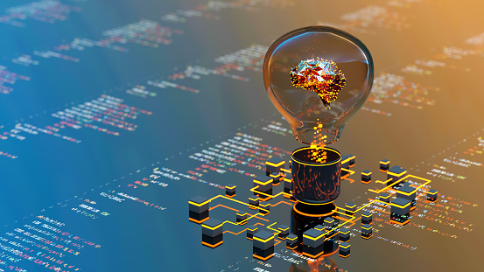
There are three types of A.I.
narrow AI, general AI, and super AI.

Slide 8
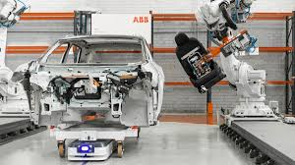
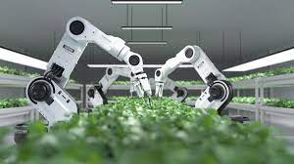
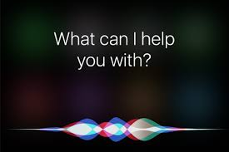
Narrow AI
Artificial narrow intelligence (ANI) is crucial to voice assistants, such as Siri, Alexa, and Google Assistant. This category includes intelligent systems that have been designed or trained to carry out specific tasks or solve particular problems, without being explicitly designed to do so.
ANI might often be referred to as weak AI, as it doesn't possess general intelligence, but some examples of the power of narrow AI include the above voice assistants, and also image-recognition systems, technologies that respond to simple customer service requests, and tools that flag inappropriate content online.

Slide 9
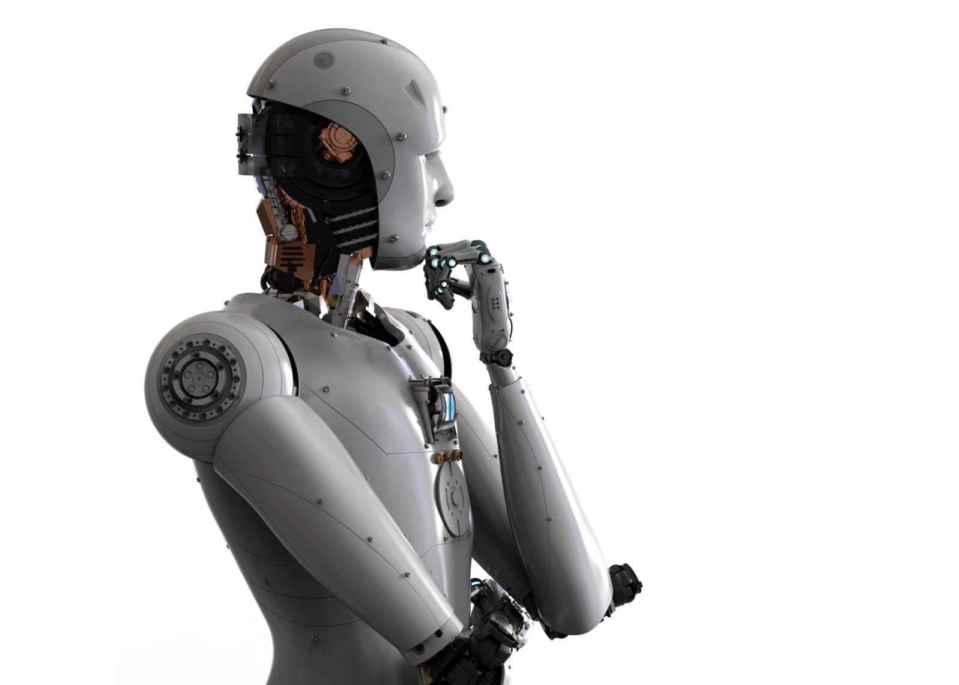
General AI
Artificial general intelligence (AGI), also known as strong AI, is still a hypothetical concept as it involves a machine understanding and performing vastly different tasks based on its accumulated experience. This type of intelligence is more on the level of human intellect, as AGI systems would be able to reason and think like a human.
Like a human, AGI would potentially be able to understand any intellectual task, think abstractly, learn from its experiences, and use that knowledge to solve new problems. Essentially, we're talking about a system or machine capable of common sense, which is currently not achievable with any form of available AI.

Slide 10
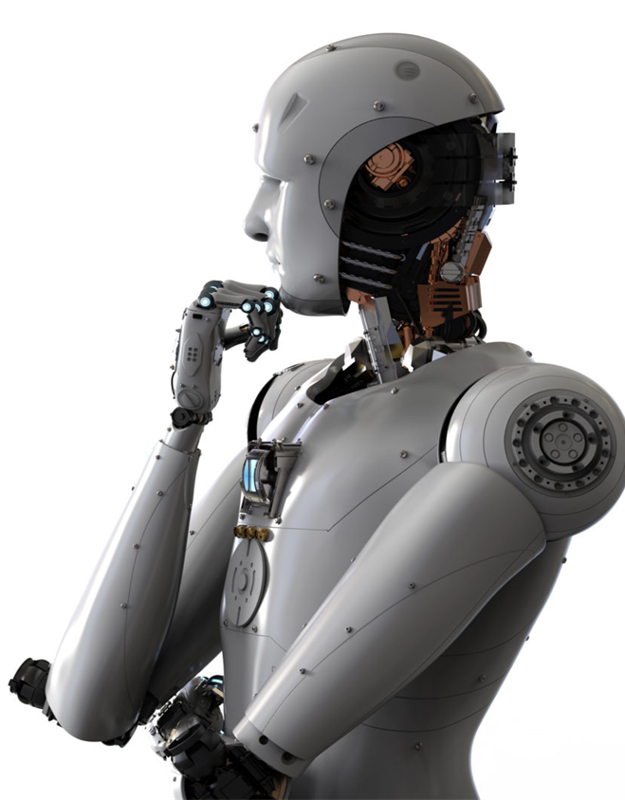
Super AI
Artificial super intelligence (ASI) is a system that wouldn't only rock humankind to its core, but could also destroy it. If that sounds straight out of a science fiction novel, it's because it kind of is: ASI is a system where the intelligence of a machine surpasses all forms of human intelligence, in all aspects, and outperforms humans in every function.
An intelligent system that can learn and continuously improve itself is still a hypothetical concept. However, it's a system that, if applied effectively and ethically, could lead to extraordinary progress and achievements in medicine, technology, and more.

Slide 11
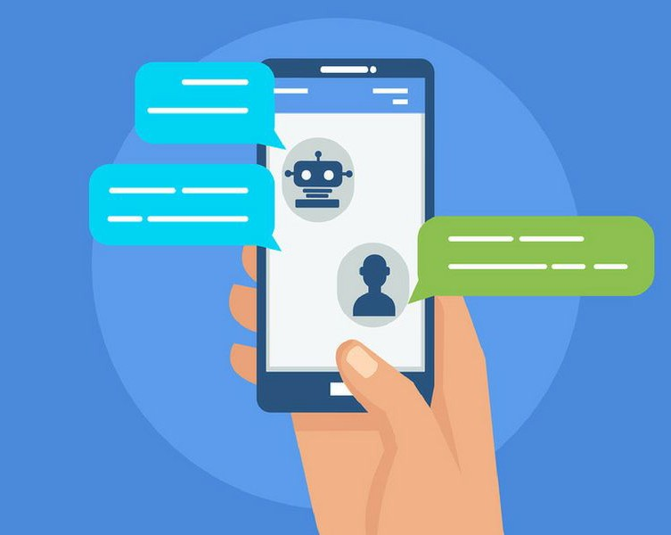
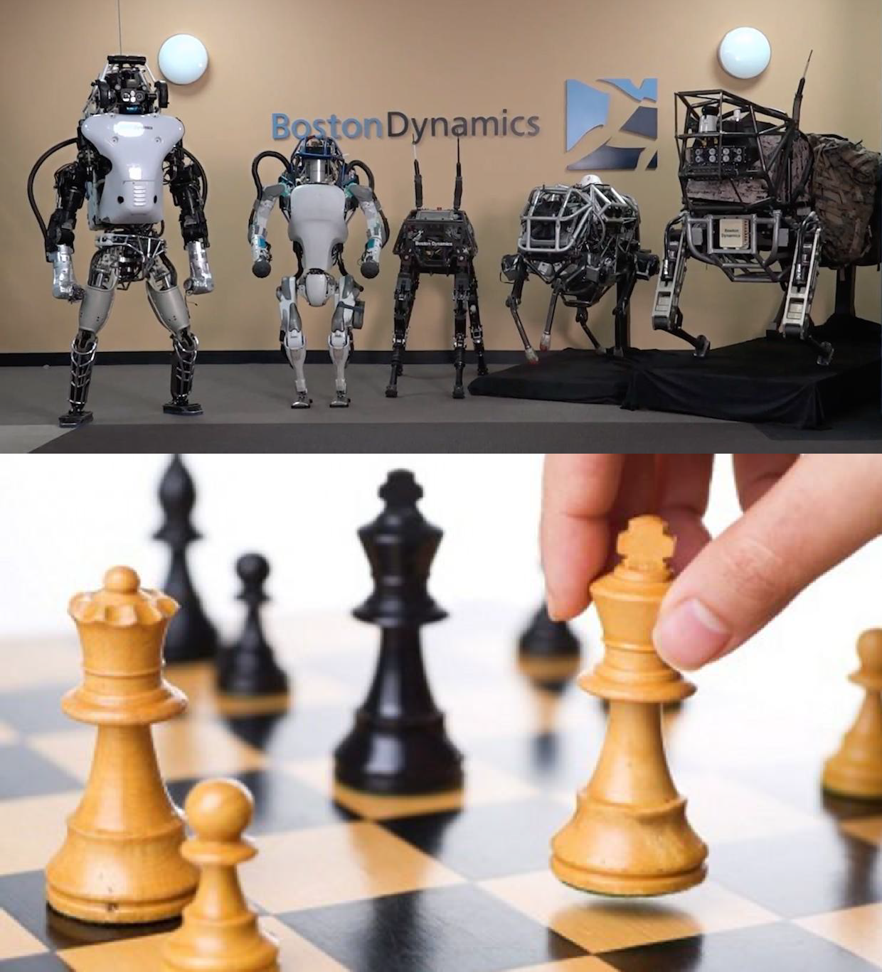
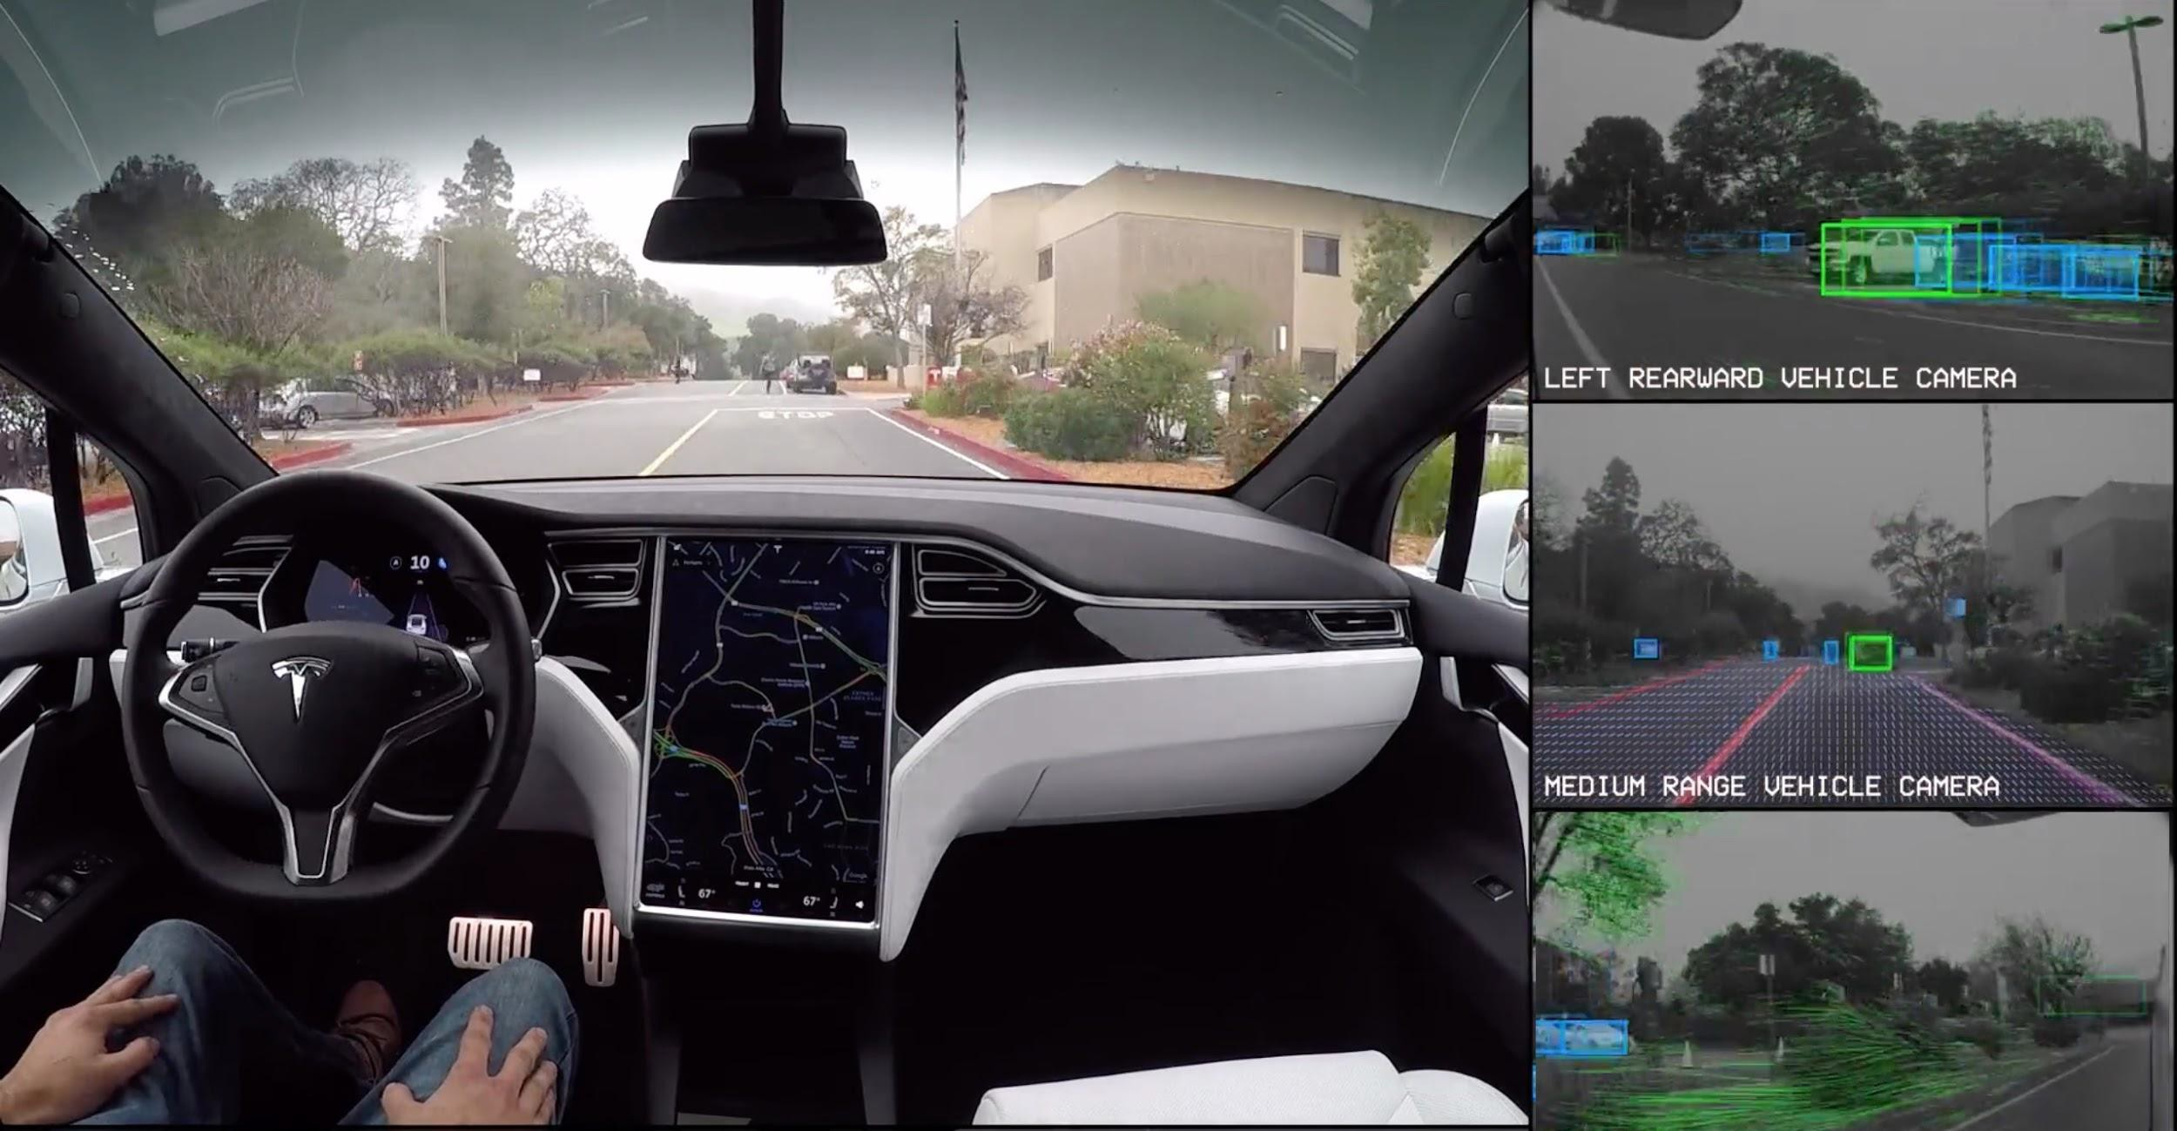
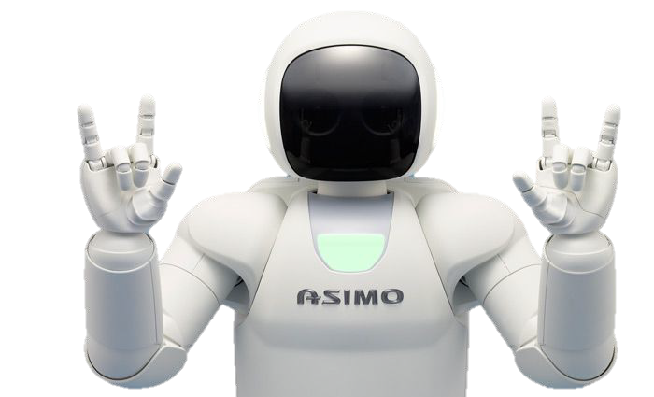
More real Life A.I. Examples
❏ Self Driving Cars
❏ Boston Dynamics
❏ Navigation
Systems
❏ ASIMO
❏ Chatbots
❏ Human vs
Computer Games
❏ Many More!

Slide 12
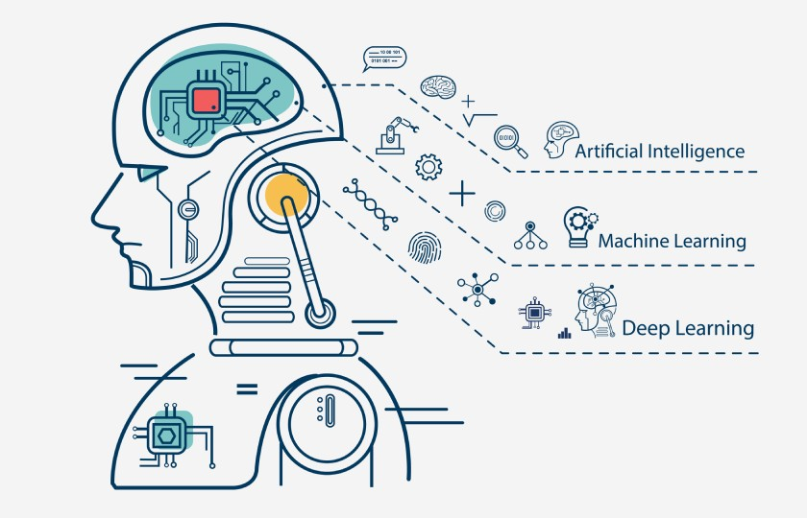
What is machine learning?
The biggest quality that sets AI aside from other computer science topics is the ability to easily automate tasks by employing machine learning, which lets computers learn from different experiences rather than being explicitly programmed to perform each task. This capability is what many refer to as AI, but machine learning is actually a subset of artificial intelligence.
Machine learning involves a system being trained on large amounts of data, so it can learn from mistakes, and recognize patterns in order to accurately make predictions and decisions, whether they've been exposed to the specific data or not.

Slide 13
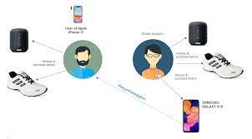
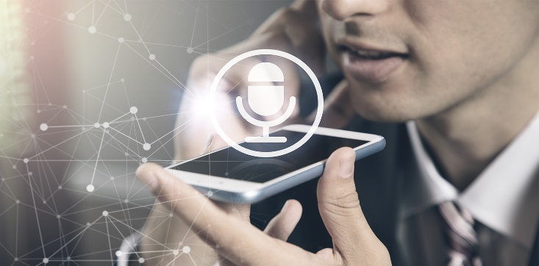
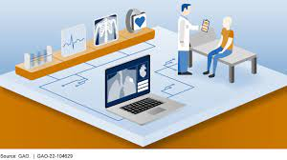
Examples of machine learning:
Image and speech recognition
Fraud protection
Product recommendations
Email automation and spam filtering
Healthcare advancement
Mobile voice to text and predictive text

Slide 14
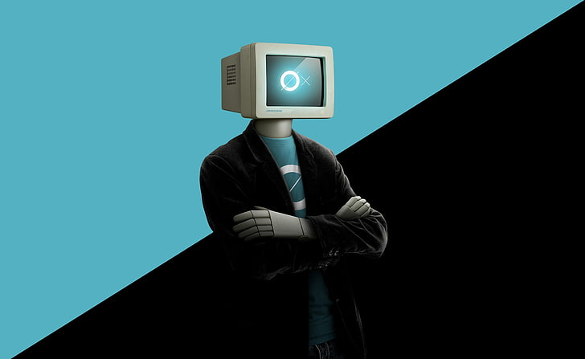
Is your computer able think like a human being?

Slide 15
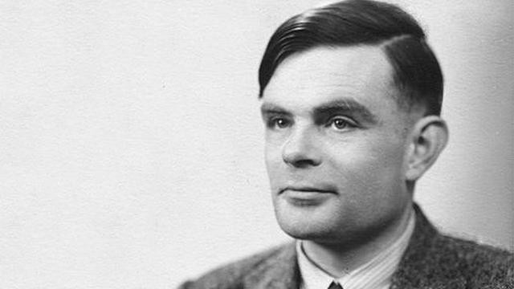
The Turing Test
In the 1950s Alan Turing created the Turing Test that is a method of inquiry in artificial intelligence (AI) for determining whether or not a computer is capable of thinking like a human being.

Slide 16
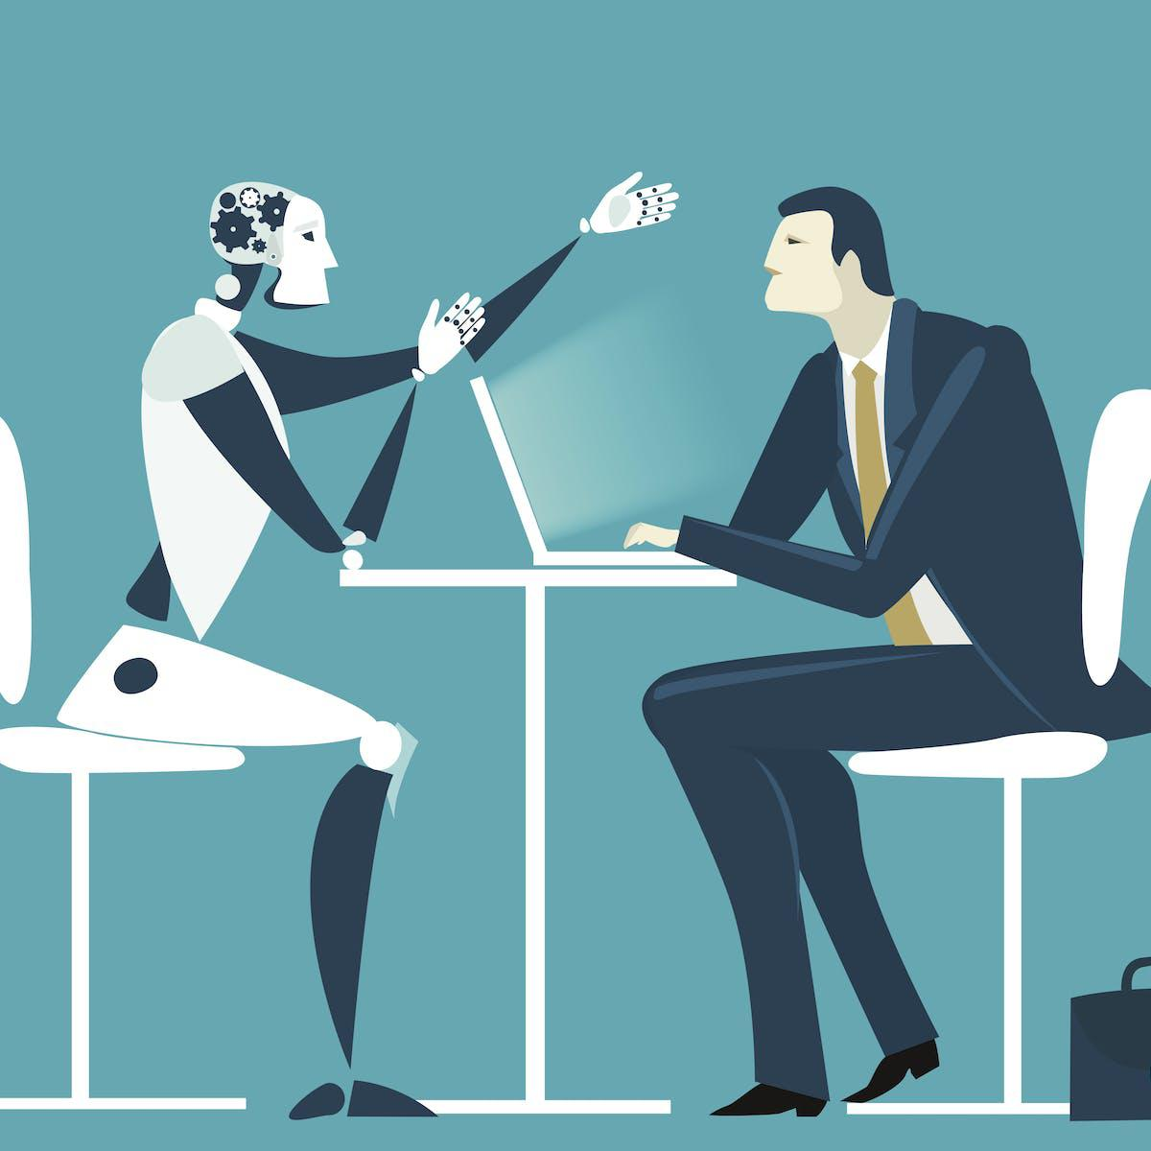
Controversy of Turing Test
Some people disagree with the Turing Test. They claim it does not actually measure a computer's intelligence.
Instead of coming up with a response themselves, they can use the same generic phrases to pass the test.

Slide 17

Benefits of A.I.
The most important purpose of
A.I. is to reduce human casualties in
Wars
Dangerous Workspaces
Car Accidents
Natural Disasters
Or to just make everyday life easier by helping with tasks such as:
Cleaning
Shopping
Transportation

Slide 18
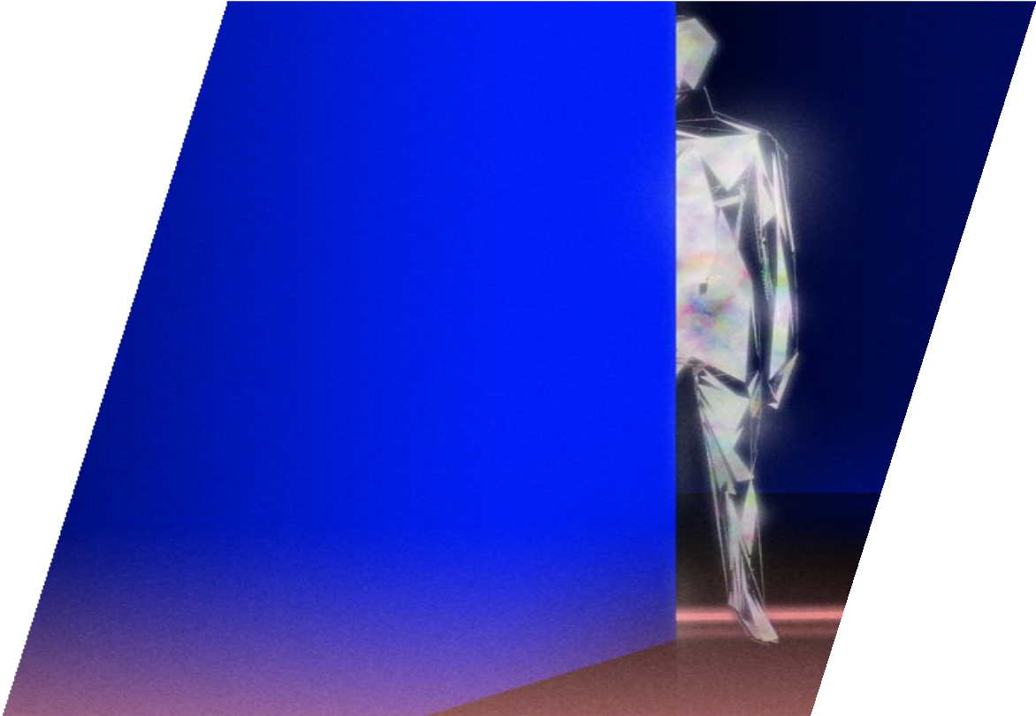

The Future of A.I.
★ Military Bots
★ The perfect lawyer
★ Music
★ Business
★ Healthcare

Slide 19
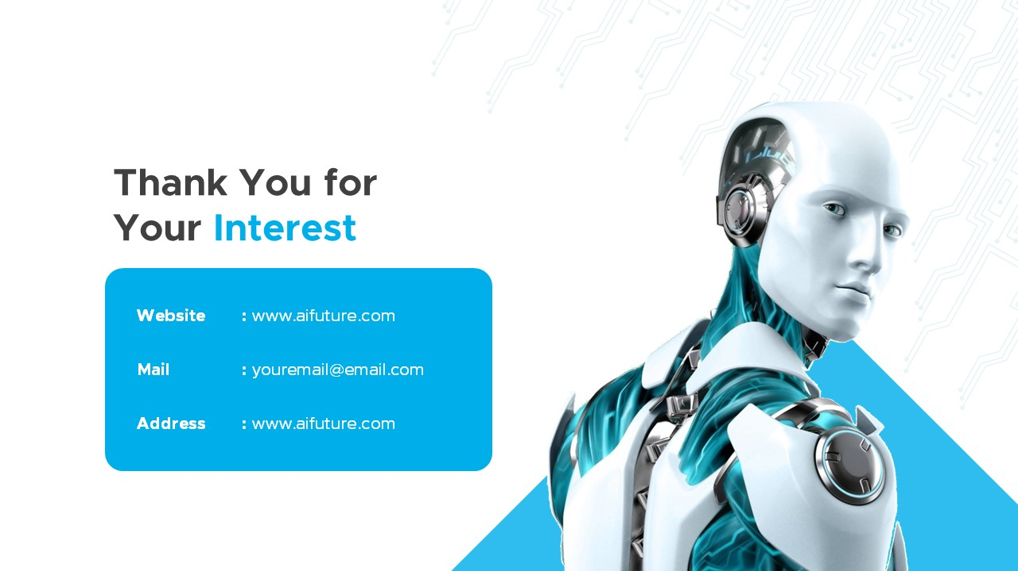
Charbel Najjour
David El Ghosein
Mario Daher
Sergei Tanios

Slide 20
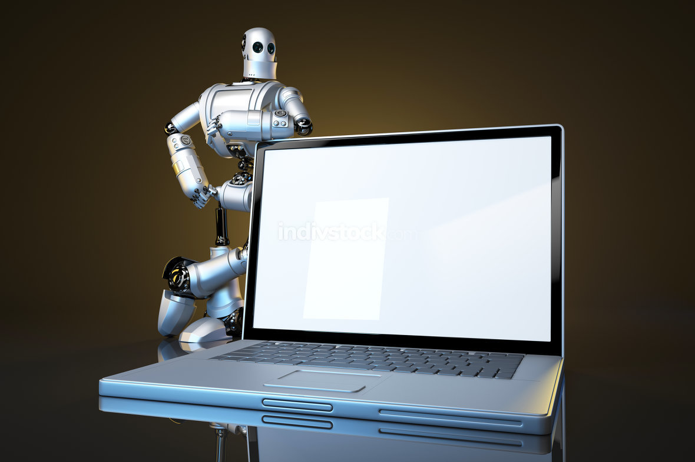
http://asimo.honda.com/
https://en.wikipedia.org/wiki/Autonomous_car
http://www.sciencemag.org/news/2017/08/how-go ogle-making-music-artificial-intelligence
http://www.legaltechnews.com/id=120279500382 7/Artificial-Intelligence-is-Molding-the-Attorney-of- the-Future?sqlreturn=20170709132104
http://www.newsweek.com/2017/08/18/ai-faceboo k-artificial-intelligence-machine-learning-robots-rob otics-646944.html
http://www.nasdaq.com/article/how-alibaba-is-usin g-artificial-intelligence-in-healthcare-cm815551
https://www.zdnet.com/article/what-is-ai-heres-everything-you-need-to-know-about-artificial-intelligence/

